Slide 1
Amazon Product Review Analysis
Presented by :-
Manthan Jagdale
Atul Kumar
Sai Vara Prasad

Slide 2
Objective
Identifying reviews as positive, negative and neutral.
Optimization of inventory by identifying the products in demand.
Demand forecasting based on customer sentiments.
Datasets:-
All beauty Review and Metadeta.(2004-2018)
Reviews -> 371,345 reviews
Size -> 226 mb
Luxury Beauty Review and Metadeta.(2001-2018)
Reviews -> 574,628 reviews
Size-> 330 mb
Source of Data

Slide 3
Description of Data
Review Datasets:-
Metadeta :-
Column | Description
reviewerID | ID of the reviewer
asin | D of the product
reviewerName | name of the reviewer
vote | helpful votes of the review
style | a disctionary of the product metadata
reviewText | text of the review
overall | rating of the product
summary | summary of the review
unixReviewTime | time of the review (unix time)
reviewTime | ime of the review (raw)
image | images that users post after they have received the product
Column | Description
title | name of the product
asin | D of the product
feature | bullet-point format features of the product
description | description of the product
price | price in US dollars (at time of crawl)
imageURL | URL of the product image
related | related products
salesRank | sales rank information
brand | brand name
categories | list of categories
tech1 | the first technical detail table of the product
tech2 | the second technical detail table of the product
similar | similar product table

Slide 4
Graphical Business Insights and observations

Slide 5

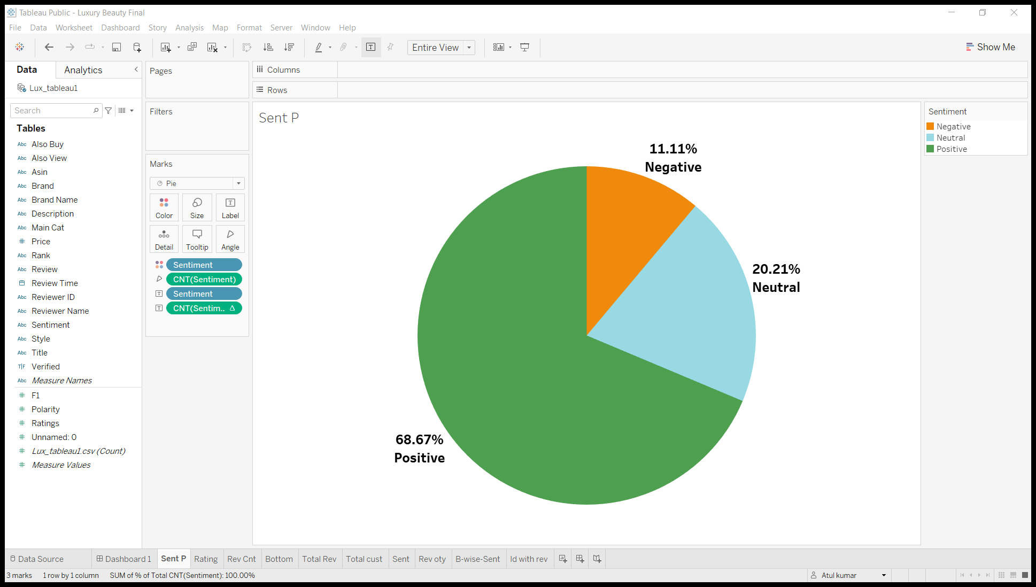
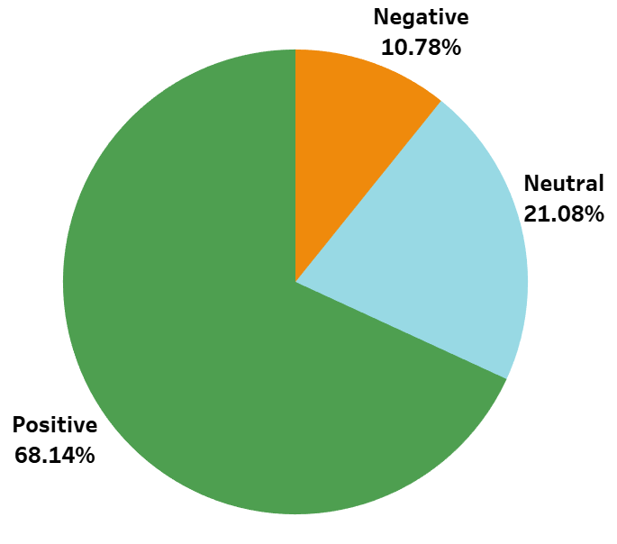
Proportion of review type
Luxury Beauty
All Beauty
In both the categories positive reviews are more as compared to the negative and neutral reviews

Slide 6
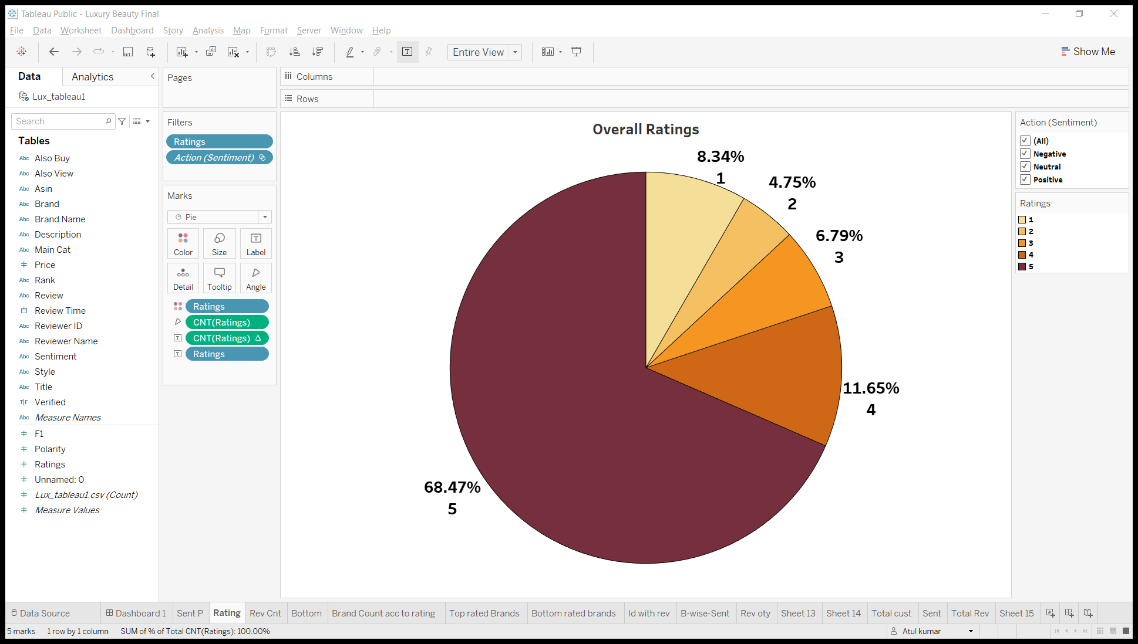
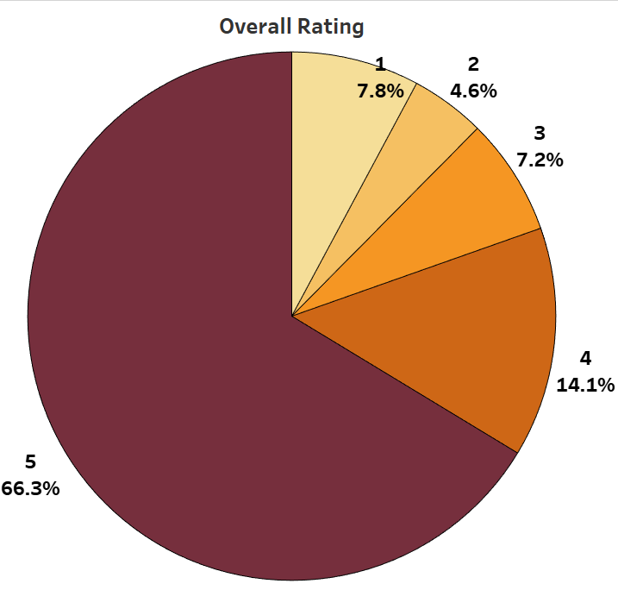
Overall Ratings Proportion
Luxury Beauty
All Beauty
5 Star had been given by most reviewers
2 Star had been given by least reviewers
5 Star had been given by most reviewers
2 Star had been given by least reviewers
In both of the dataset the proportion of rating is nearly same

Slide 7
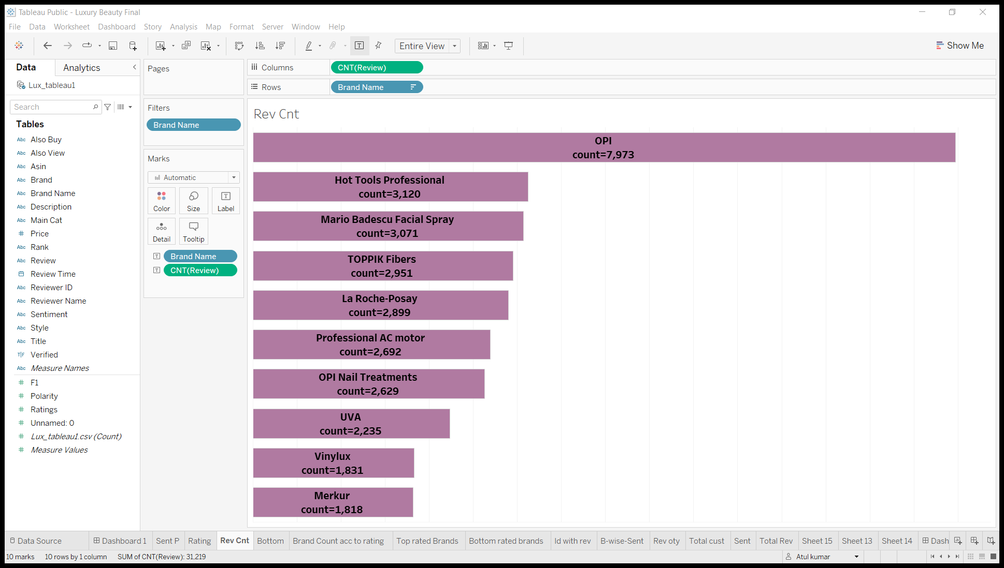
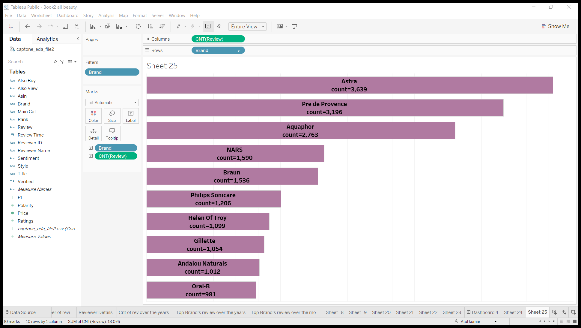
Top 10 brands with most number of reviews
Luxury Beauty
All Beauty

Slide 8
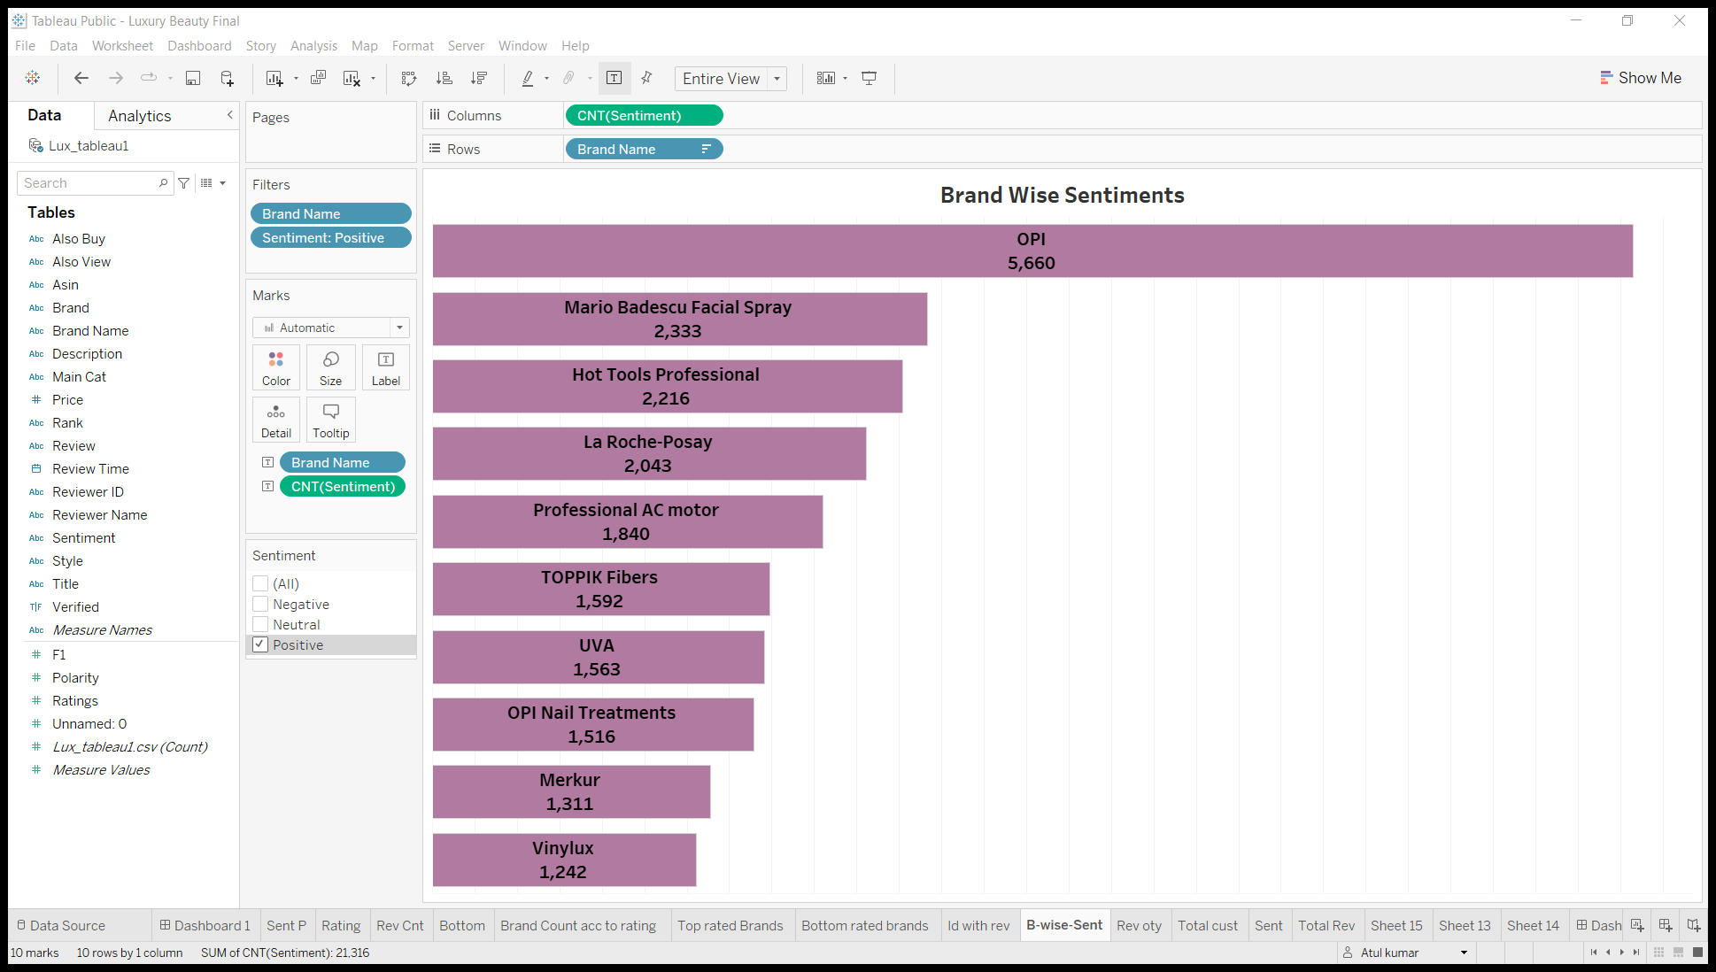
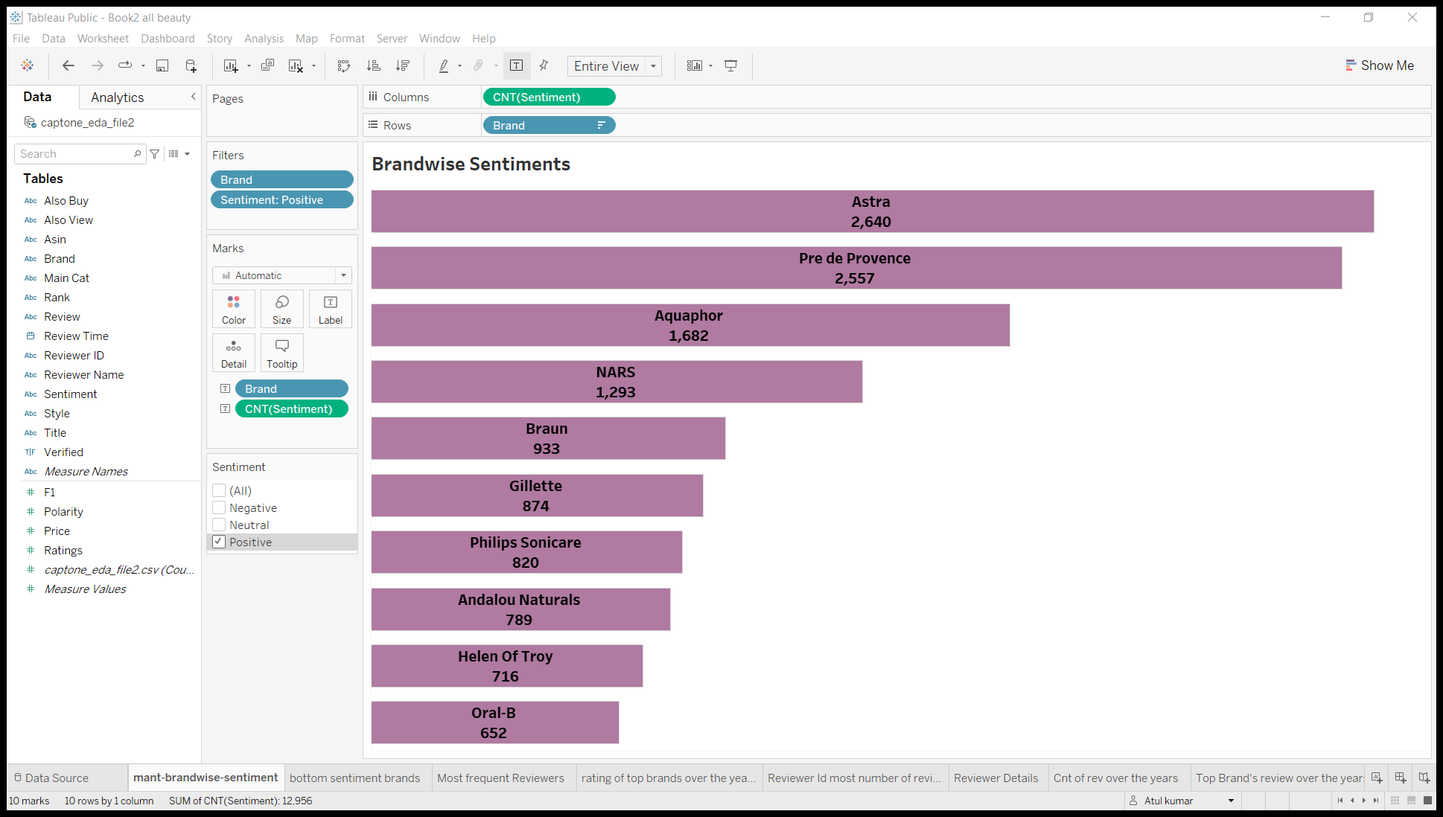
Brands with most number of reviews with respect to positive reviews
Luxury Beauty
All Beauty

Slide 9
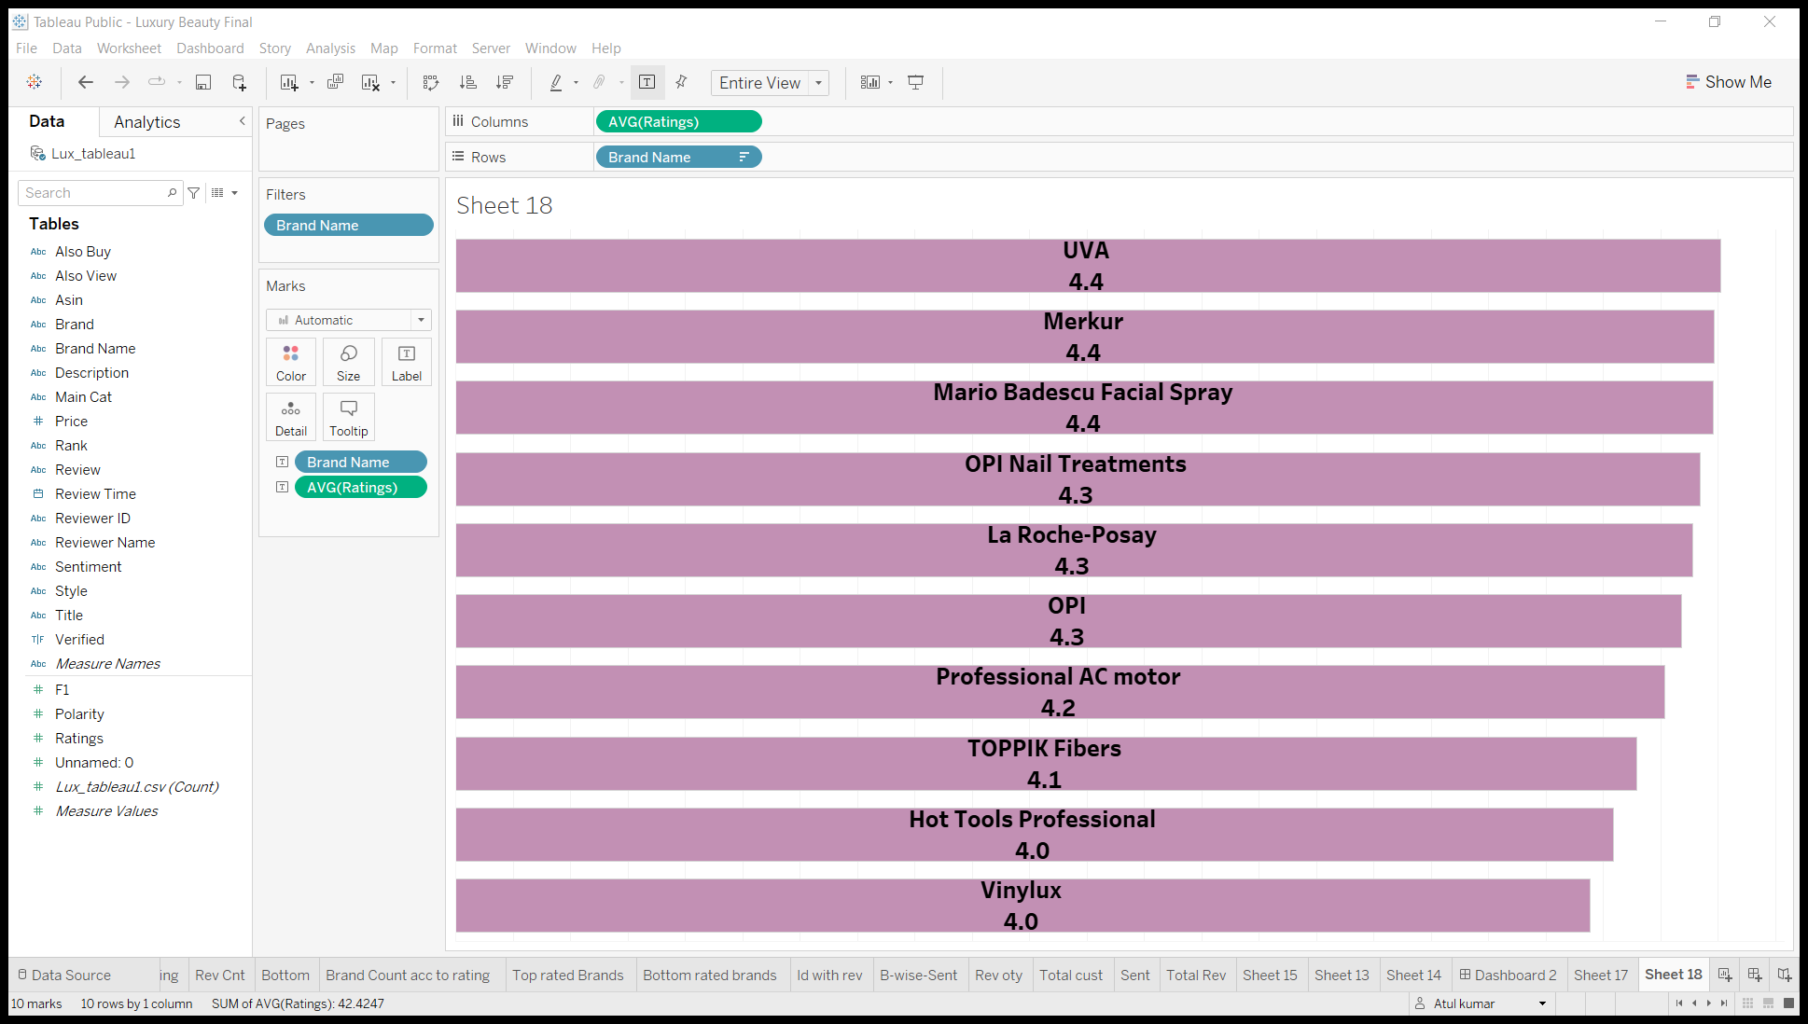
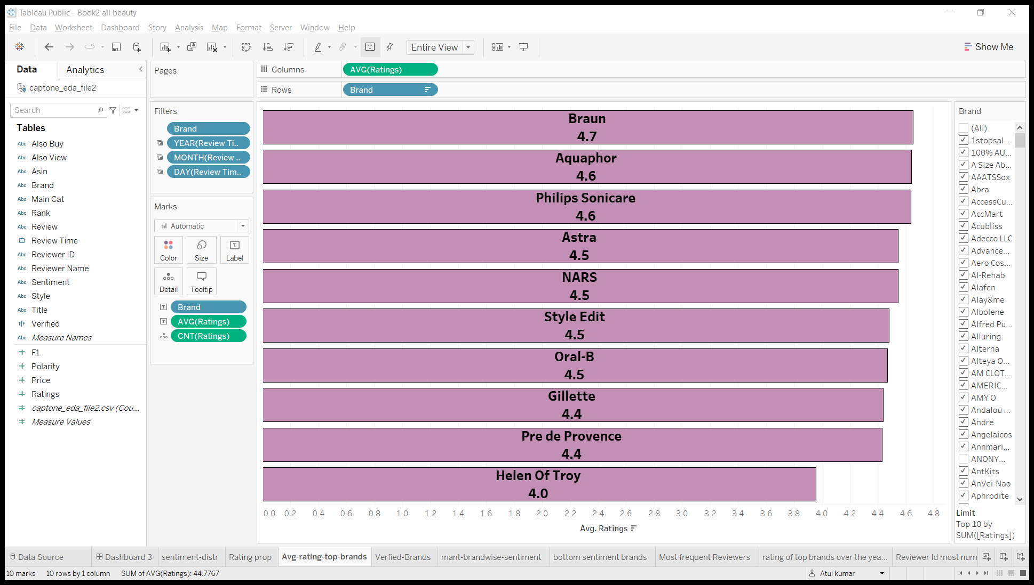
Average rating of the top 10 identified brands
Luxury Beauty
All Beauty

Slide 10
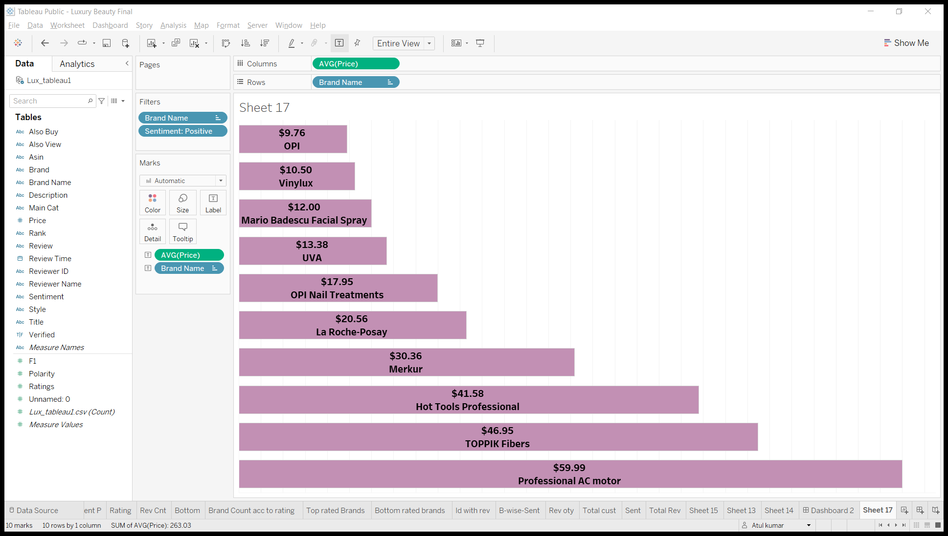
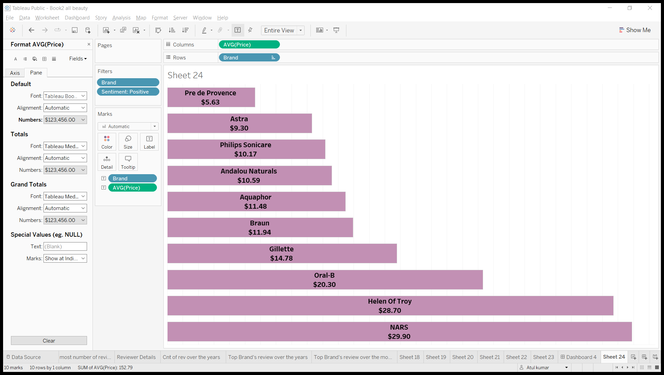
Average price of top 10 identified brands
Luxury beauty
Avg price=$33.1
All beauty
Avg price=$17.13

Slide 11
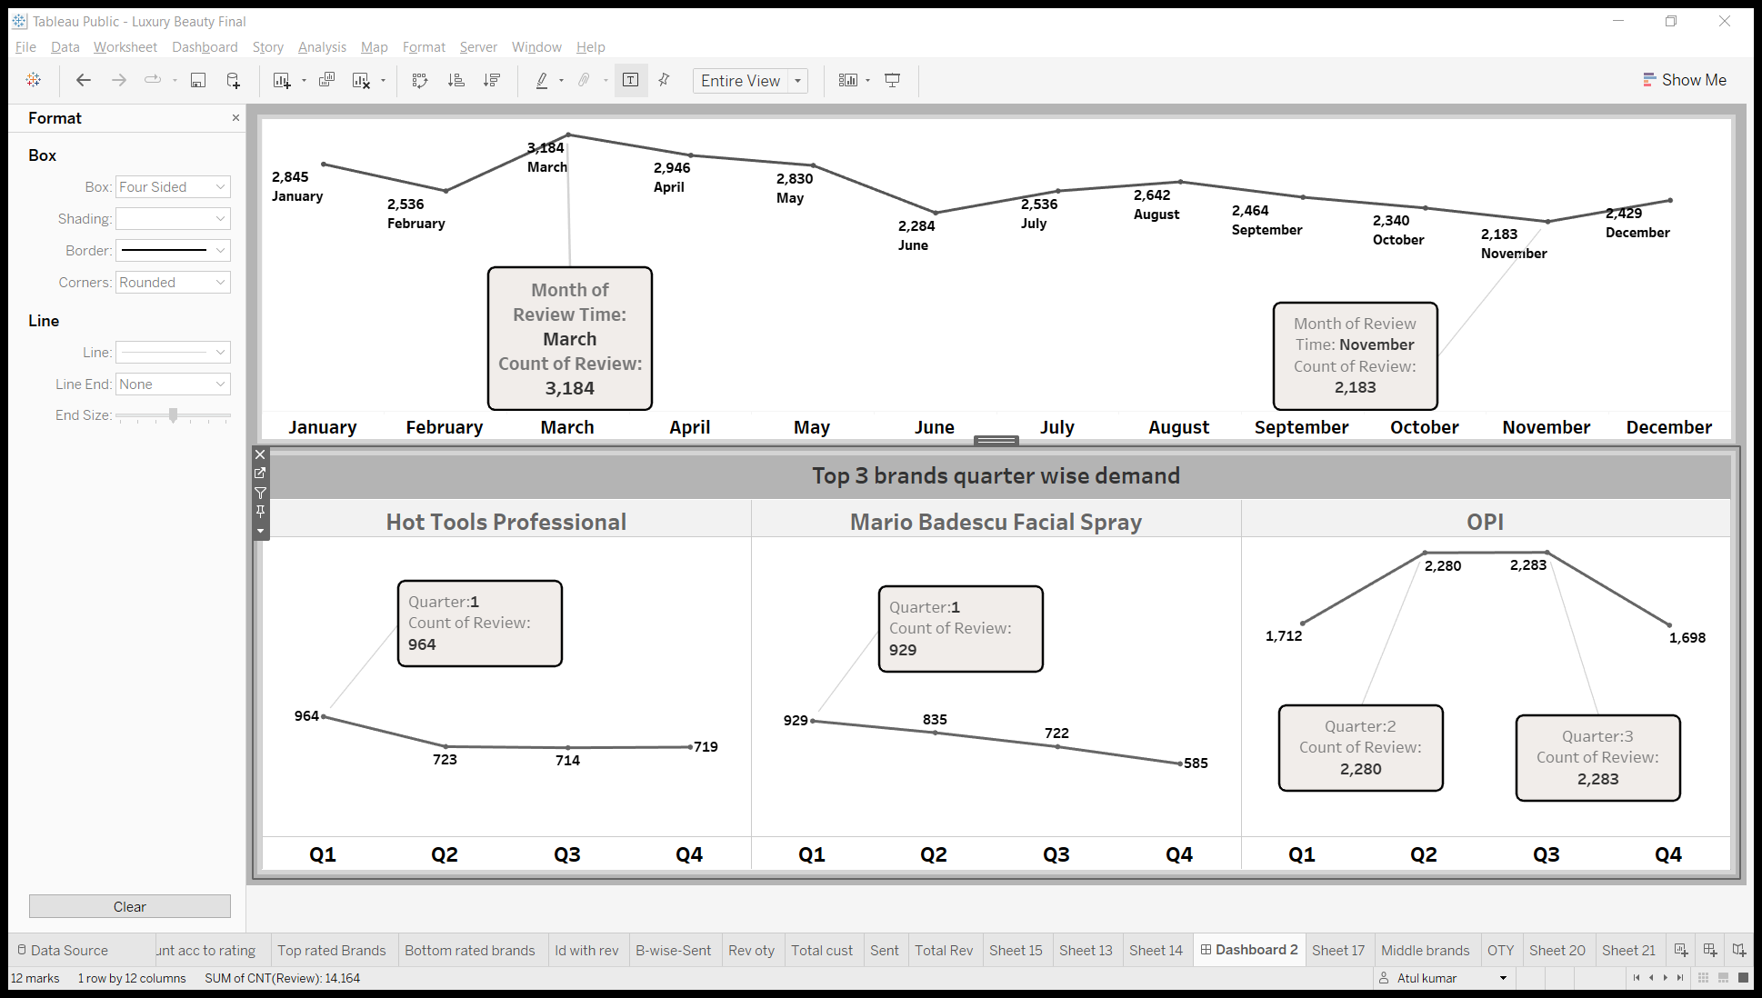
Count of review of top 10 brands over the months in Luxury dataset

Slide 12
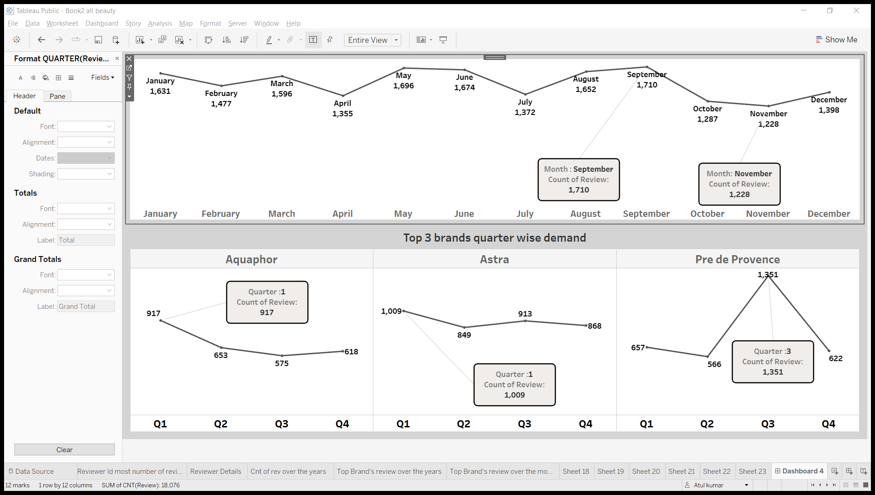
Count of review of top 10 brands over the months in All beauty dataset

Slide 13
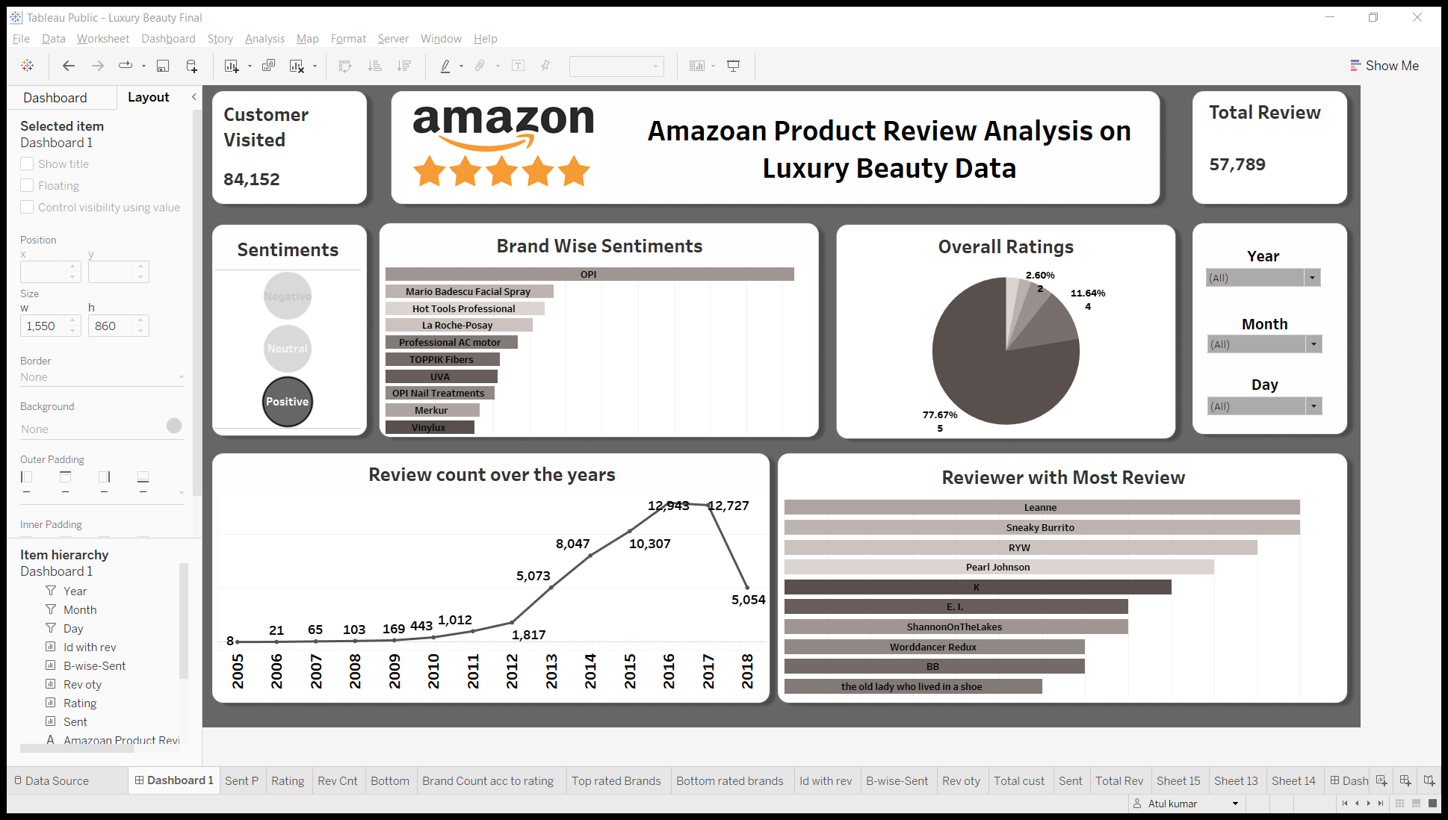
Dashboard
To see the dashboard->
Dashboard Link
{All Beauty}
To see the dashboard->
Dashboard Link
{Luxury Beauty}

Slide 14
Time series analysis of customer reviews(Future prediction of type of customer review )

Slide 15
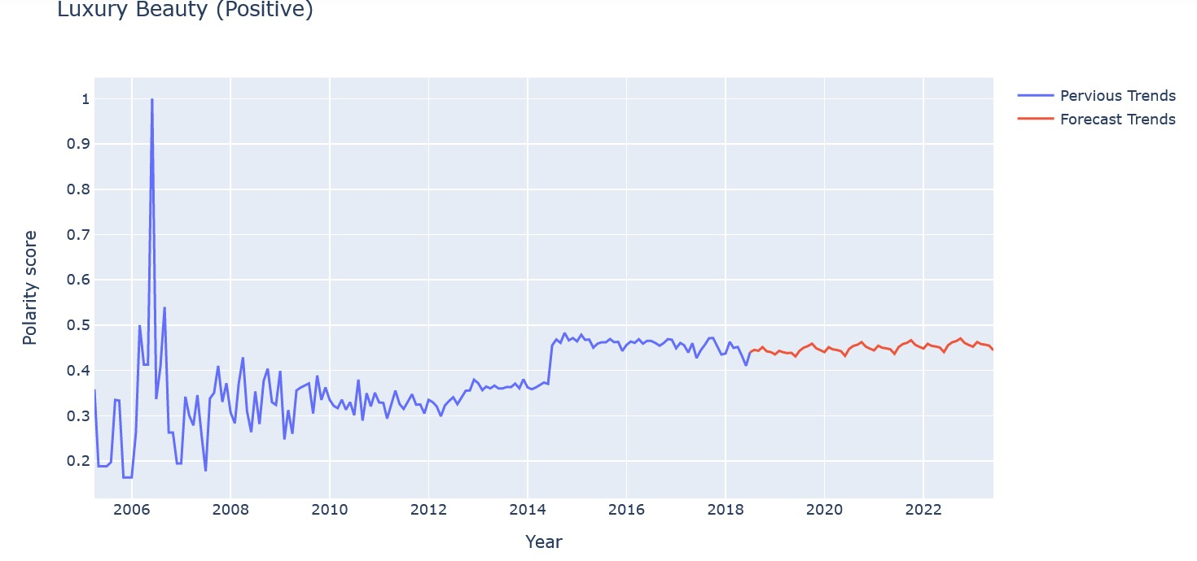
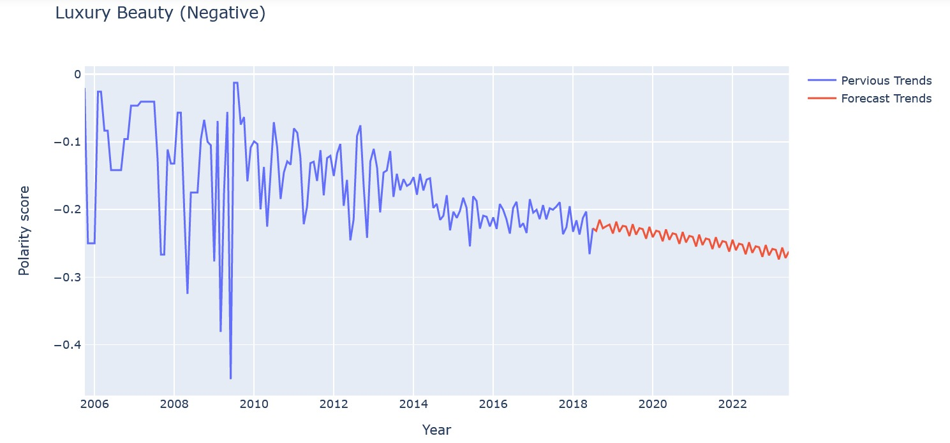
Luxury Beauty review type Forecast
Positive reviews of customer buying Luxury beauty products are expected to increase.
Positive
Negative review of customer buying Luxury beauty products are also expected to increase.
Negative

Slide 16
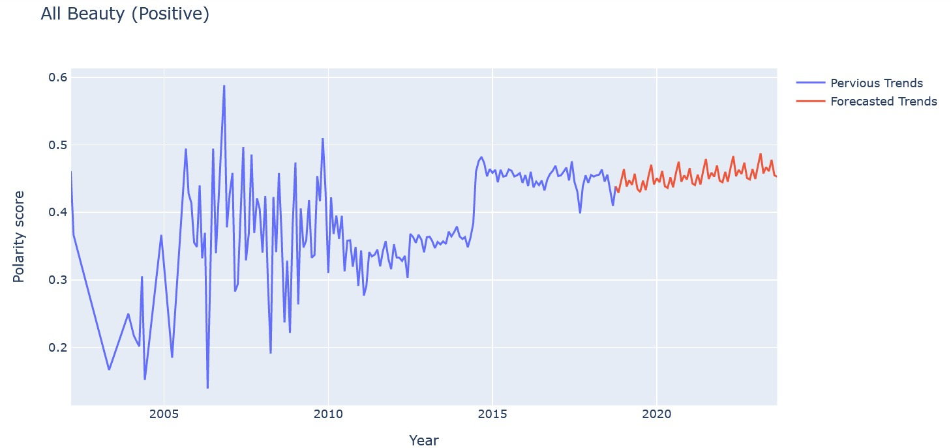

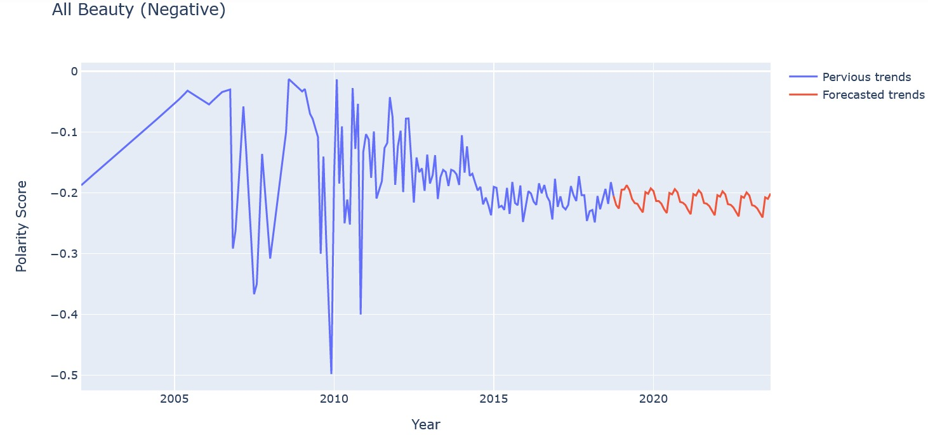
All Beauty review type Forecast
Positive reviews of customer buying All beauty products are expected to increase steadily.
Negative reviews of customer buying All beauty products are expected to increase.
Negative

Slide 17
Technical Analysis
Models used and their performances
Time Series analysis Results:-
Dataset | Sentiments | Model Used | RMSE | MSE
Luxury beauty | Positive | SARIMA | 0.05358 | 0.00286
 | Negative | SARIMA | 0.02437 | 0.00059
All Beauty | Positive | SARIMA | 0.03111 | 0.00096
 | Negative | SARIMA | 0.02801 | 0.00078

Slide 18
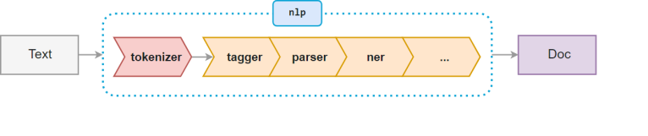
Library used for sentiment analysis:-
Text Blob
Input- Review text
Output- Polarity score and subjectivity
Range for positive review-> 0.1 to 1 (polarity score)
Range for negative review-> 0 to -1(polarity score)
Range for neutral reviews-> 0 to 0.1 (polarity score)
Problem in luxury beauty dataset:-
In luxury beauty we had approx. 99% empty string in the column ‘brand’, replacing them with any Statistical measure will have cause unnecessary biasness in the data. To overcome this problem we used NER (Named Entity Recognition) in which we derived the brand name from description of the product by identifying the organization(org) name.

Slide 19
Business Insights
Positive sentiment reviews are more in number than negative sentiment reviews
Reason for review type:-
Positive:-Good quality, good packaging, receive compliments ,comfortable, amazing smell, moisturizes well, even textured, soft touch, long-lasting.
Negative:-Costly, awful, products is not same as expected, less quantity, poor quality,
dull, sticky, waste of money ,bad packaging.
After the analysis we observed that the positive reviews are going to increase.
Demand for top performing brands is expected to increase
Top 3 identified brands for Luxury beauty :-
OPI (Nail care/ Polish ) → Most demanded in Quarter-2 and Quarter-3
Mario Badescu facial spray(Skincare) → Most demanded in Quarter-1
Hot Tools Professional(hair curling iron) → Most demanded in Quarter-1
Top 3 identified brands for All beauty :-
Astra (Razor) → Most demanded in Quarter-1
Aquaphor(Healing Ointment) → Most demanded in Quarter-1
Pre de province(soap) → Most demanded in Quarter-3
We identified these brands after observing the analysis that these 3 brands have nearly 50% of review in top 10 brands

Slide 20
After the analysis we also observed that for better optimization of inventory:-
For luxury beauty category, we are getting most review in month of march so as we approach the month of march we can increase the stocks of luxury beauty products.
For All beauty category, we are getting most review in month of September so as we approach the month of September we can increase the stocks of luxury beauty products.
We also observe that customers tend to buy the beauty products which are relatively lower in price as compared to average price of all products.
As the customer engagement(number of reviews) is increasing we observed that average price is also decreasing for top 10 products, so we can say that to increase sales reduction in average price of products can be an advantage.
Thank You

